Slide 1
Chapter 7 Deadlocks

Slide 2
教学内容、目标与要求
教学内容
系统模型
死锁特征
死锁处理方法
死锁预防
死锁避免
死锁检测
死锁恢复
教学重点与难点
重点：1、2、5、6
难点：5、6
教学目标与要求
理解死锁现象；
掌握系统模型描述方法；
掌握死锁特征和死锁处理方法。

Slide 3
Contents
7.1 System Model
7.2 Deadlock Characterization
7.3 Methods for Handling Deadlocks
7.4 Deadlock Prevention
7.5 Deadlock Avoidance
7.6 Deadlock Detection
7.7 Recovery from Deadlock

Slide 4
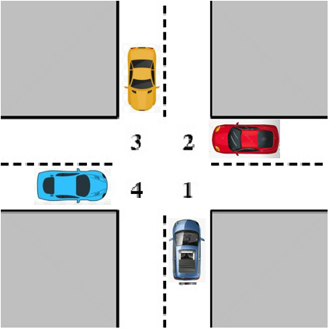
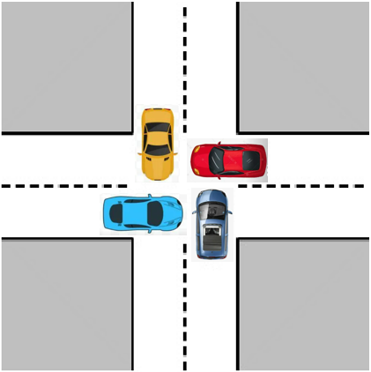
Deadlock Model
Deadlock possible
Deadlock
遵守交通法规，维护交通秩序
合理有序使用资源、大局意识

Slide 5
Bridge Crossing Example
Traffic only in one direction.
Each section of a bridge can be viewed as a resource.
If a deadlock occurs, it can be resolved if one car backs up (preempt resources and rollback).
Several cars may have to be backed up if a deadlock occurs.
Starvation is possible.
合理有序使用资源
大局意识

Slide 6
Deadlock Problem in Computer System
A set of blocked processes each holding a resource and waiting to acquire a resource held by another process in the set.
Example 1
System has 2 tape drives.
P₁ and P₂ each hold one tape drive and each needs another one.
Example 2
semaphores A and B, initialized to 1
P₀ P₁
wait (A); wait(B)
wait (B); wait(A)
P₀: wait (A);
P₁: wait (B);
P₀: wait (B);
P₁: wait (A);

Slide 7
Example of Deadlock
Progress of Q
Q:
wait(B); ①
wait(A); ②
…// using A&B
signal(B);
signal(A);
P:
wait(A); ③
wait(B); ④
…// using A&B
signal(A);
signal(B);
release A
P and Q Want A
release B
P and Q want B
Get A
①②③④
Deadlock
inevitable
③④①②
Get B
①③…
③①…
Progress of P
Get A
Get B
release A
release B

Slide 8
Example of No Deadlock
Progress of Q
Q:
wait(B); ①
wait(A); ②
… // using A&B
signal(B);
signal(A);
P:
wait(A); ③
… // using A
signal(A);
wait(B); ④
… // using B
signal(B);
release A
P and Q
Want A
release B
P and Q
want B
Get A
①②③④
③④①②
Get B
①③②…
Progress of P
③①②…
Get A
release A
Get B
release B

Slide 9
7.1 System Model
CPU、memory space
Resource types R₁, R₂, . . ., R_{m}
CPUs, memory space, files, I/O devices (printers)
The resources may be either physical resources or logical resources.
physical resources— preemptive resources / non-preemptive resources
logical resources—temporary resources, known as consumable resources
Each resource type R_{i} has W_{i} instances.
Each process utilizes a resource as follows:
A system table records whether each resource is free or allocated, and if a resource is allocated, to which process.
printer、tape drive
request
use
Release

Slide 10
产生死锁的原因
系统资源与死锁
竞争资源
进程间推进顺序
永久性资源（物理资源）
可剥夺资源（可重用资源）
资源被剥夺走时，对进程不产生破坏性的影响， 如：内存、CPU。
一旦再次获得资源，很容易恢复进程的执行。
不可剥夺资源（非剥夺性资源）
资源被剥夺走时，可能引起进程执行失败， 如打印机。
不当竞争，可能引起死锁。
临时性资源（逻辑资源）
由一个进程产生，被另一个进程使用一短暂时间后便无用的资源，也称为消耗性资源。
竞争临时性资源也可能引起死锁。

Slide 11
7.2 Deadlock Characterization
Mutual exclusion: only one process at a time can use the resource.
Hold and wait: a process holding at least one resource is waiting to acquire additional resources held by other processes.
No preemption: a resource can be released only voluntarily by the process holding it, after that process has completed its task.
Circular wait: there exists a set {P₀, P₁, …, P_{n}} of waiting processes such that P₀ is waiting for a resource that is held by P₁, P₁ is waiting for a resource that is held by P₂, …, P_{n–1} is waiting for a resource that is held by P_{n} ,and P_{n} is waiting for a resource that is held by P₀.
A deadlock situation can arise if the above four conditions hold simultaneously.

Slide 12
Resource-Allocation Graph
Deadlock can be described in terms of a System resource-allocation graph.
Directed graph.
A set of vertices V and a set of edges E.
V is partitioned into two different types:
P = {P₁, P₂, …, P_{n}}, consisting of all the processes in the system.
R = {R₁, R₂, …, R_{m}}, consisting of all resource types in the system.
E is classed into two different types:
request edge -- directed edge P_{i} → R_{j,} Process P_{i} requested an instance of resource type R_{j}, and is currently waiting for that resource.
assignment edge -- directed edge R_{j} → P_{i,} An instance of resource type R_{j} has been allocated to process P_{i} .
P_{i}
R_{j}
P_{i}
R_{j}

Slide 13
Example of Resource Allocation Graph
R₁
R₃
R₁
R₃
P₂
:
•
•
•
•
P₁
P₂
P₃
P₁
P₂
P₃
R₁
P₁
P₃
:
:
…
:
…
R₂
P₄
R₂
R₄
R₂
R₄
no cycle
with deadlocks
with a cycle but no deadlock
13

Slide 14
Basic Facts
graph contains no cycles ⇒ no deadlock.
graph contains a cycle:
1. If only one instance per resource type ⇒ deadlock.
If the cycle involves only a set of resource types, each of which has only a single instance ⇒ deadlock.
Each process involved in the cycle is deadlocked.
a cycle in the graph is both a necessary and a sufficient condition for the existence of deadlock.
2. each resource type involved in the cycle has several instances ⇒ possibility of deadlock.
a cycle in the graph is a necessary but not a sufficient condition for the existence of deadlock.

Slide 15
7.3 Methods for Handling Deadlocks
Ensure that the system will never enter a deadlock state.
Deadlock-prevention
Deadlock-avoidance
Allow the system to enter a deadlock state, detect it, and then recover.
Ignore the problem and pretend that deadlocks never occur in the system.
used by most operating systems, including UNIX, Windows.

Slide 16
7.4 Deadlock Prevention
防患未然
Mutual Exclusion – not required for sharable resources; must hold for nonsharable resources.
Hold and Wait – must guarantee that whenever a process requests a resource, it does not hold any other resources.
Two alternations:
Require each process to request and be allocated all its resources before it begins execution. Disadvantages: Low resource utilization;
Allow a process to request resources only when it has none (release resources first). Disadvantages: Starvation possible.

Slide 17
Deadlock Prevention
No Preemption
two alternations
Resources being held by requesting process are preempted. The process must wait with no resources.
If a process holding some resources requests another resource that cannot be immediately allocated to it, then all resources currently being held are released.
Preempted resources are added to the list of resources for which the process is waiting.
Waiting with holding resources, but resources may be preempted by other process requesting them.
Often applied to resources whose state can be easily saved and restored later, such as CPU registers and memory space.

Slide 18
Deadlock Prevention
Circular Wait – impose a total ordering of all resource types, and require that each process requests resources in an increasing order of enumeration.
Sorting position of resource Ri —F(Ri).
Two alternations:
The process can request instances of resource type Rj if and only if F(Rj)>F(Ri). If several instances of the same resource type are needed, a single request for all of them must be issued.
Whenever a process requests an instance of resource type Rj, it has released any resources Ri such that F(Ri)>=F(Rj).
…
R₁
R₂
R₃
R₄
R₅
R₆
R₇
R₈
R₉
R₁₀
R₁₁
R_{n}

Slide 19
7.5 Deadlock Avoidance
Simplest and most useful model requires： each process declare the maximum number of resources of each type that it may need.
The deadlock-avoidance algorithm dynamically examines the resource-allocation state to ensure that a circular-wait condition can never exist.
Resource-allocation state is defined by the number of available, allocated resources, and the maximum demands of the processes.

Slide 20
Safe State
When a process requests an available resource, system must decide if immediate allocation leaves the system in a safe state.
System is in safe state only if there exists a safe sequence of all processes.
Sequence <P₁, P₂, …, P_{n}> is a safe sequence if for each P_{i} , the resources that P_{i} can still request can be satisfied by currently available resources + resources held by all the P_{j} , with j<i.
If the resources that P_{i} needs are not immediately available, then P_{i} can wait until all P_{j} have finished.
When P_{j} is finished, P_{i} can obtain needed resources, execute, return its allocated resources, and terminate.
When P_{i} terminates, P_{i+1} can obtain its needed resources, and so on.

Slide 21
Basic Facts
If a system is in safe state ⇒ no deadlocks.
deadlocked ⇒ unsafe.
If a system is in unsafe state ⇒ possibility of deadlock.
unsafe
deadlock
safe
Total: 12
Max current Need
needs holding
P₀ 10 5 5
P₁ 4 2 2
P₂ 9 2 7
2
3
P₁，5
P₁，4
P₀，10
safe sequence: P₁, P₀, P₂
3 6
P₂，12
Avoidance ⇒ ensure that the system will never enter an unsafe state.

Slide 22
Resource-Allocation Graph Algorithm
Claim edge P_{i} → R_{j} indicated that process P_{i} may request resource R_{j} in the future; represented by a dashed line.
Claim edge P_{i} → R_{j} converts to request edge when P_{i} requests R_{j}.
Request edge P_{i} → R_{j} converts to assignment edge when the instance of resource type R_{j} has been allocated to process P_{i}.
Assignment edge R_{j} → P_{i} reconverts to a claim edge P_{i} → R_{j} when a R_{j} is released by P_{i.}
Resources must be claimed a priori in the system.

Slide 23
Resource-Allocation Graph Algorithm
In a resource-allocation system with only one instance of each resource type.
Pi requests Rj.
The request can be granted only if converting Pi → Rj to Rj → Pi does not result in the formation of a cycle in the resource-allocation graph.
Check for safety by using a cycle-detection algorithm.
If no cycle exists, the allocation of the resource will leave the system in a safe state.
If a cycle is found, then the allocation will put the system in an unsafe state. In that case, Pi will have to wait for its requests to be satisfied.

Slide 24
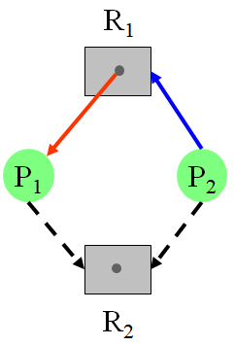
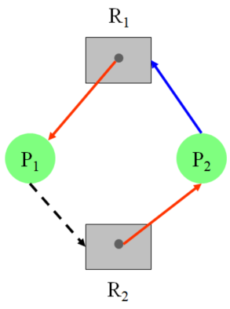
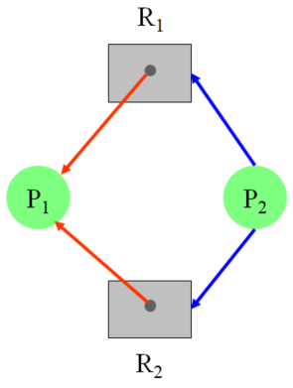
Resource-Allocation Graph Algorithm
?
?
unsafe
safe

Slide 25
Banker’s Algorithm
Applicable to a resource-allocation system with multiple instances of each resource type.
Each process must a priori claim maximum use of instances of each resource type.
When a process requests a set of resources, the system must determine whether the allocation of these resources will leave the system in a safe state.
If it will, the resources are allocated;
Otherwise, the process must wait until some other process releases enough resources.
When a process gets all its resources it must return them in a finite amount of time.

Slide 26
Data Structures for the Banker’s Algorithm
n = number of processes m = number of resources types
Available: Vector of length m. If available [j] = k, there are k instances of resource type R_{j} available.
Max: n × m matrix. If Max [i, j] = k, then process P_{i} may request at most k instances of resource type R_{j}.
Allocation: n × m matrix. If Allocation[i, j] = k, then P_{i} is currently allocated k instances of R_{j.}
Need: n × m matrix. If Need[i, j] = k, then P_{i} may need k more instances of R_{j} to complete its task.
Need [i, j] = Max[i, j] – Allocation [i, j]

Slide 27
Notation
Let X and Y be vectors of length n.
X≤Y ⇐⇒ X[i]≤Y[i] for all i=1, 2, …, n
Each row in the matrices allocation and need can be treated as vectors and referred to as allocation_{i} and need_{i}
Allocation_{i} -- specifies the resources currently allocated to process P_{i}
Need_{i} -- specifies the additional resources that process P_{i} may still reauest to complete its task.

Slide 28
Safety Algorithm
1. Let Work and Finish be vectors of length m and n, respectively. Initialize:
Work = Available
Finish [i] = false for i = 1,2, …, n.
2. Find an index i such that both:
(a) Finish[i] = false (b) Need_{i} ≤ Work
If no such i exists, go to step 4.
3. Work = Work + Allocation_{i} Finish[i] = true go to step 2.
4. If Finish [i] == true for all i, then the system is in a safe state.

Slide 29
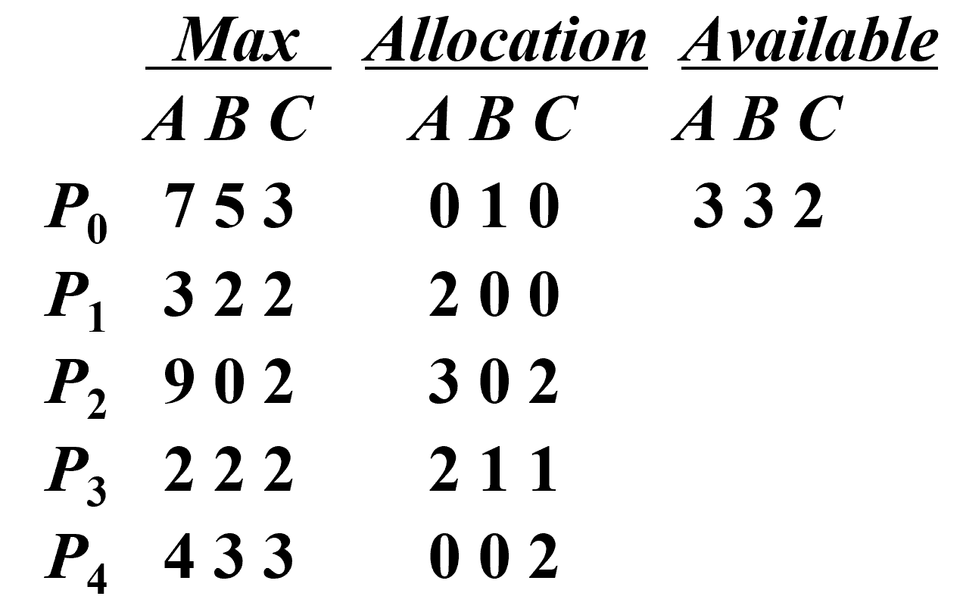
Example of Safety Algorithm
Finish | 0 | 1 | 2 | 3 | 4
 | false | false | false | false | false
A system with
5 processes P₀ through P₄
3 resource types A (10 instances), B (5 instances), and C (7 instances).
Snapshot at time T₀:
true
true
true
true
true
work
Need
A B C
P₀ 7 4 3
P₁ 1 2 2
P₂ 6 0 0
P₃ 0 1 1
P₄ 4 3 1
Seq.
3 3 2
5 3 2
P₁
P₃
P₄
P₀
P₂
+
7 4 3
+
7 4 5
7 5 5
10 5 7

Slide 30
Resource-Request Algorithm
Request_{i} = request vector for process P_{i}.
Request_{i} [j]=k, P_{i} wants k instances of resource type R_{j.}
When a request for resource is made by process P_{i}
If Request_{i} ≤ Need_{i} go to step 2. Otherwise, raise error condition.
If Request_{i} ≤ Available, go to step 3. Otherwise P_{i} must wait.
Pretend to allocate requested resources to P_{i} by modifying the state as follows:
Available = Available - Request_{i};
Allocation_{i} = Allocation_{i} + Request_{i};
Need_{i} = Need_{i} – Request_{i};
If safe ⇒ the resources are allocated to P_{i}. If unsafe ⇒ P_{i} must wait, and the old resource-allocation state is restored.
计划、诚信
大局、全局

Slide 31
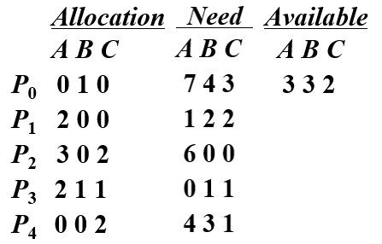
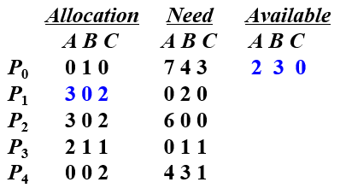
Example of Banker’s Algorithm
Suppose request₁=(1,0,2).
Check, Request₁ ≤ Need₁ =(1,2,2)
Check, Request₁ ≤ Available =(3,3,2)
Pretend this request has been fulfilled.
Determine whether this new state is safe.
The request of P₁ can be granted immediately.
Seq. Work
2 3 0
P₁
P₃
P₄
P₀
P₂
5 3 2
7 4 3
7 4 5
Safe!
7 5 5
10 5 7

Slide 32
Example of Banker’s Algorithm
New state:
Can request for (3, 3, 0) by P₄ be granted?
request₄=(3, 3, 0) >= Available=(2, 3, 0)
P₄ cannot be granted, P₄ waits.
Can request for (0, 2, 0) by P₀ be granted?
Unsafe, cannot be granted, P₀ waits.
0 3 0 7 2 3
2 1 0
Safe?

Slide 33
7.6 Deadlock Detection
定期检查
Allow system to enter deadlock state
Detection algorithm
Recovery scheme
Two situations
systems with only a single instance of each resource type
systems with several instances of each resource type

Slide 34
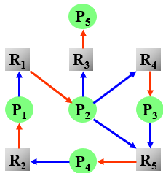
Single Instance of Each Resource Type
P₅
⇒
P₁
P₂
P₃
P₄
Maintain wait-for graph
Nodes are processes.
P_{i}→P_{j} if P_{i} is waiting for the resource held by P_{j}.
P_{i}→P_{j} exists in wait-for graph ⬅➔ ∃q, P_{i} → R_{q} and R_{q} → P_{j} exist in resource-allocation graph.

Slide 35
Single Instance of Each Resource Type
A deadlock exists in the system ⬅➔ the wait-for graph contains a cycle.
To detect deadlocks, the system needs
maintain the wait-for graph.
Periodically invoke an algorithm that searches for a cycle in the graph.
An algorithm to detect a cycle in a graph requires an order of n² operations, where n is the number of vertices in the graph.

Slide 36
Several Instances of a Resource Type
Several time-varying data structures used.
Available: A vector of length m indicates the number of available resources of each type.
Allocation: An n × m matrix defines the number of resources of each type currently allocated to each process.
Request: An n × m matrix indicates the current request of each process. If Request [i, j] = k, then process P_{i} is requesting k more instances of resource type R_{j}.
Rows in Allocation and Request can be treated as vectors, and referred to as Allocation_{i} and Request_{i} respectively.

Slide 37
Detection Algorithm
1. Let Work and Finish be vectors of length m and n, respectively. Initialize:
(a) Work = Available
(b) For i=1, 2, …, n, if Allocation_{i}≠0, then Finish[i] = false; otherwise, Finish[i] = true.
2. Find an index i such that both:
(a) Finish[i] == false (b) Request_{i} ≤ Work
If no such i exists, go to step 4.
3. Work = Work + Allocation_{i} Finish[i] = true go to step 2.
4. If Finish[i] == false, for some i, 1 ≤ i ≤ n, then the system is in a deadlock state.
If Finish[i] == false, then P_{i} is deadlocked.

Slide 38
Example of Detection Algorithm
A system with Five processes P₀ through P_{4,}, three resource types A (7 instances), B (2 instances), and C (6 instances).
Snapshot at time T₀:
Allocation Request Available
A B C A B C A B C
P₀ 0 1 0 0 0 0 0 0 0
P₁ 2 0 0 2 0 2
P₂ 3 0 3 0 0 0
P₃ 2 1 1 1 0 0
P₄ 0 0 2 0 0 2
Sequence <P₀, P₂, P₃, P₄, P₁> will result in Finish[i] = true for all i.
Seq. Work
0 0 0
P₀ 0 1 0
P₂ 3 1 3
P₃ 5 2 4
P₄ 5 2 6
P₁ 7 2 6
finish
P₀ false
P₁ false
P₂ false
P₃ false
P₄ false
true
true
true
true
true

Slide 39
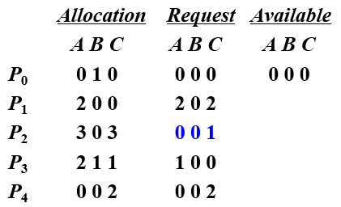
Example of Detection Algorithm
Suppose P₂ requests an additional instance of type C.
State of system?
insufficient resources to fulfill other processes’ requests.
Deadlock exists. Processes P₁, P₂, P₃, and P₄ are deadlocked.
Seq. Work
0 0 0
P₀ 0 1 0

Slide 40
Detection-Algorithm Usage
When, and how often, to invoke depends on:
How often is a deadlock likely to occur?
How many processes will need to be rolled back?
one for each disjoint cycle
Deadlocks occur only when some process makes a request that cannot be granted immediately.
Invoke the deadlock detection algorithm every time a request for allocation cannot be granted immediately.
incur considerable overhead in computation time.
invoke the algorithm at defined intervals, once per hour or whenever CPU utilization drops below 40 percent.
If detection algorithm is invoked arbitrarily, there may be many cycles in the resource graph, and so we would not be able to tell which of the many deadlocked processes “caused” the deadlock.

Slide 41
资源图消边法检测死锁
P₀
P₁
P₂
·······
··
······
A
B
C
P₃
P₄
request edge
assignment edge

Slide 42
资源图消边法检测死锁
P₀
P₁
P₂
·······
··
······
A
B
C
P₃
P₄
request edge
assignment edge

Slide 43
7.7 Recovery from Deadlock
When a deadlock exists
Inform the operator, deal with the deadlock manually. or
Let the system to recover from the deadlock automatically.
To break a deadlock
Abort one or more processes.
Preempt some resources from one or more of the deadlocked processes.
成本? 规则? 公平？
制定规则

Slide 44
Process Termination
To eliminate deadlock by aborting a process.
Abort all deadlocked processes.
Abort one process at a time until the deadlock cycle is eliminated.
System reclaims all resources allocated to the terminated processes.
In which order should we choose a process to abort?
Priority of the process.
How long the process has computed, and how much longer to completion.
How much and what type of resources the process has used.
How much more resources the process needs to complete.
How many processes will need to be terminated.
Is the process interactive or batch?
成本?

Slide 45
Resource Preemption
Successively preempt some resources from processes and give these resources to other processes until the deadlock cycle is broken.
Selecting a victim – which resources and which processes are to be preempted?
Minimize cost.
Rollback – return the process to some safe state, and restart it from that state.
Total rollback: abort the process and then restart it.
Starvation – the same process may always be picked as victim.
Include the number of rollbacks in cost factor.
公平?

Slide 46
Combined Approach to Deadlock Handling
Combine the three basic approaches
prevention
avoidance
detection
allowing the use of the optimal approach for each of resources in the system.
Partition resources into hierarchically ordered classes.
Use most appropriate technique for handling deadlocks within each class.

Slide 47

课后作业及研究性学习
作业
掌握死锁特征
掌握死锁避免算法，如安全算法、银行家算法；
掌握死锁检测算法。
研究性学习
针对不同的死锁预防策略，分析器实现可行性、存在的主要问题、以及性能。

